Slide 1


Beer & Wine
TEAM
Amanda Belloma, Dallas Diaz, Jamie Lewis, Tim Raynor

Slide 2
INSPIRATION & THEME
Our love of spirits in all their delightful forms, of course!
General research question:
Do correlations exist between a state’s demographics, such as population and median income, and the number of breweries and wineries located in the state?

Slide 3
DATA SOURCES
UNITED STATES INCOME BY STATE
Income by state data was sourced from the United States Census Bureau. Data includes median household income by state from 1984 to 2018. Standard deviations are included as well. Link Here
WINERIES
Data related to the number of wineries in the United States was obtained from wine-road.com (source data attributed to The National Association of American Wineries). Data includes the number of wineries grouped by state. Link Here
BREWERIES
Data related to the number of breweries in the United States was obtained kaggle.com. Data includes brewery name, type, address, website, state, total breweries in state. Link Here
Found a more comprehensive list https://www.brewersassociation.org/directories/breweries/ & https://en.wikipedia.org/wiki/List_of_breweries_in_the_United_States
POPULATION BY STATE
Population by state for several years, using 2018 as the most current to match the income by state from the United States Census Bureau. Link Here
STATE BOARDERS GEOJSON
https://eric.clst.org/tech/usgeojson/

Slide 4
DATA MUNGING
Dropped unused data
Renamed columns
Uppercase state columns to allow for better matching
Searched data frames to validate data could be pulled
Consolidated data using using groupby function
Web scraping for full list of breweries

Slide 5
CODING APPROACH & INTERACTIVE TOOLS
PYTHON FLASK SERVER
SQLite
JAVASCRIPT
JSON
D3 GEODATA
HTML
CSS
CHLOROPLETH MAPS
INTERACTIVE BUBBLE CHARTS
DROP-DOWN WITH KEY DATA BY STATE

Slide 6
HURDLES & CHALLENGES
Attempted web scraping for list of breweries
Goal to get to use to get LAT/LON from Google API
Too many formats for all 50 states
Challenges getting the choropleth inside the Bootstrap framework – finally did get a version to work

Slide 7
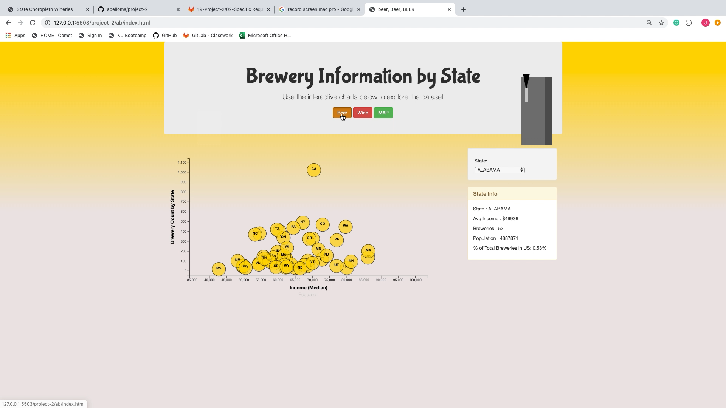
DEMO

Slide 8
THOUGHTS, QUESTIONS & SUGGESTIONS

